Slide 1
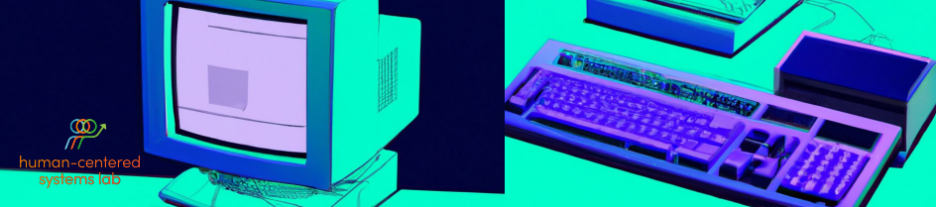
Affective User Research & Human-AI Interaction Seminar
Final Presentation
Team 3：Zhaotai Liu, Simon Meding, Jinglin Chen

Slide 2




Importance of Human-Machine Interaction
More and more use cases for LLMs
Effectivness depends on user-interaction
understanding users emotional responses is crucial
Notes:
AI and LLMs in particular are becoming increasingly important
Understanding how humans interact with these machines is more important than ever. Specifically, Large Language Models, or LLMs, are being used in diverse fields, ranging from education, simple information gathering to customer service
However, their effectiveness is not just about their capabilities but also about how users interact with them and the emotions these interactions evoke.
Therefore it is crucial to understand the users emotional responses to the models

Slide 3
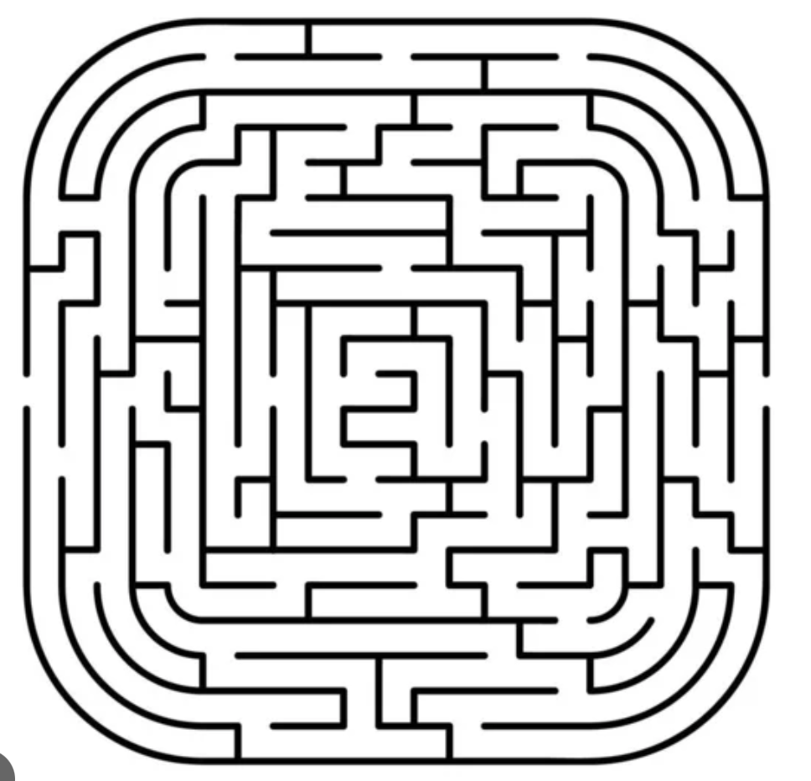

Problem
More use cases = more tasks to fullfill
Higher variation in complexity of the tasks
Higher variation in target groups
Notes:
the more llms are used, the more use cases are created, the more tasks or problems the llms are expected to solve
A central question in our research is how the complexity of the tasks given to the users and the individual characteristics of these users influence their emotional responses. Understanding this can help in designing more effective and user-friendly AI systems.”

Slide 4

Research Question
How do the task complexity and user characteristic influence user emotions during prompting?
Task Complexity
Emotion
User Characteristics
Notes:
Based on the information it should be possible to integrate that in new models to upgrade the user experience and therefore the effectiveness

Slide 5
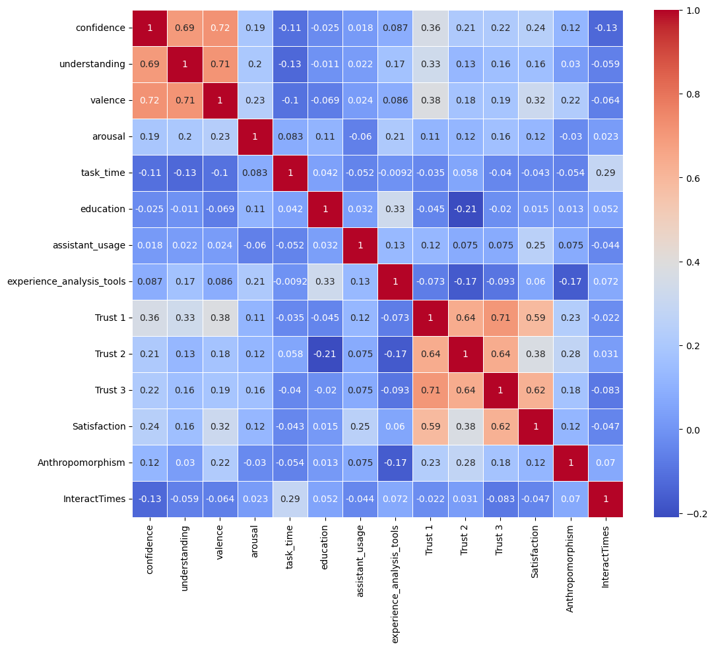

Feature Engineering
Target Variables(Valence)
Task Complexity （Information Finding)
Manuel assigned Complexity
Prompt Times
Length of Prompt
Task Time (negative effect)
User Characteristics
Education level
Understanding
Satisfaction
experience_analysis_tools
Notes:
Valence is highly correlated with Confidence and Understanding, but they are also highly correlated with each other.

Slide 6

Data Processing
Merging the Datasets:
User Information
Emotion Event
Messages Data
Handling Missing Values
Relabeling of Target Variable
Notes:
Count the number of times users interact with LLM on each question, which can be interpreted as the complexity of the task
Remove all rows that have missing values in the target variable
Change the value of valence, set 1 and 2 to -1, 3 and 4 to 0, 5 and 6 to 1

Slide 7
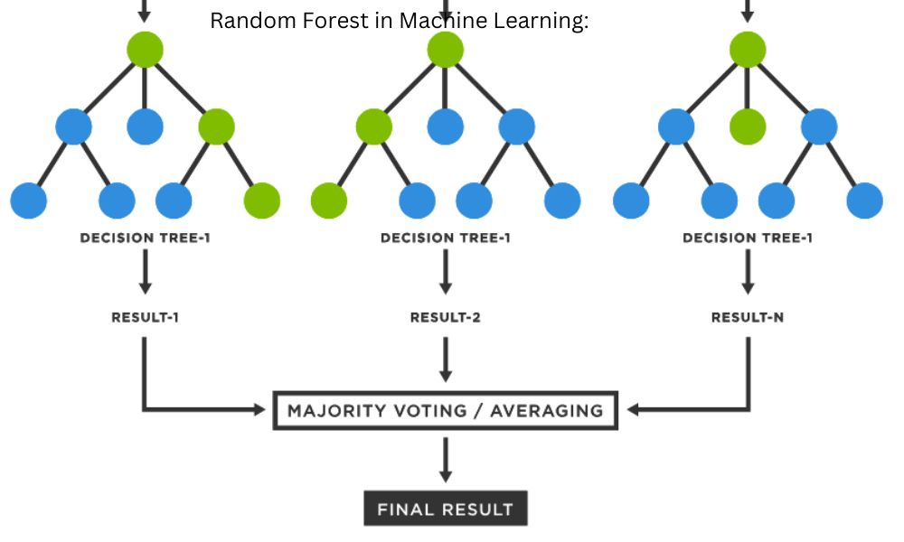
Model Realization
Random Forest Classifier
Deal with multiple features
Deal with discrete data
Each tree is independent and can be computed in parallel
Effective with classification task
Picture Source:Understanding Random Forest in Machine Learning: An Ensemble Learning Approach Explained - TheContentFarm.Net
Notes:
We decided to choose random forest based model
Depending our data characteristic—after data processing, our data is mainly discrete numbers And our prediction rely on multiple features that we choose before
Random forests can simultaneously consider the impact of multiple features on multiple target variables, allowing for more comprehensive predictions.
Additionally, random forests can integrate the prediction results of each tree through voting or averaging methods.

Slide 8
Model Realization
Data Split
Decision Tree of Task Complexity Features
Majority Vote
…………n
Predicted Valence A
…………….
Sub Tree 2
Tree 1
Input (Training Dataset)
Final Prediction
Sampling
Averaging
Decision Tree of User Characteristic Features
Majority Vote
Predicted Valence B
…………n
…………….
Sub Tree 2
Tree 1
Notes:
And about our model in to specific research questions
First we have to clean the data first, then split out data into tranning data set and testing dataset
And for now the idea is we build the 2 random forest model ，use the majority vote to give their prediction separately when we get the predictions, averaging them or use Query to Committee(QBC) to get the final answer---
Examine the impact of these two aspects on emotions.
We also think about combine all the features we chosen, and build one random forest model to do valance predion and about this model, the future work we will evaluate the model performance among two model build strategies by using MSE
And improve the model performance by adjusting the hyperparameters and … Pre user experience research

Slide 9
Thank you
Notes:
Future work: 参数设置

Slide 10
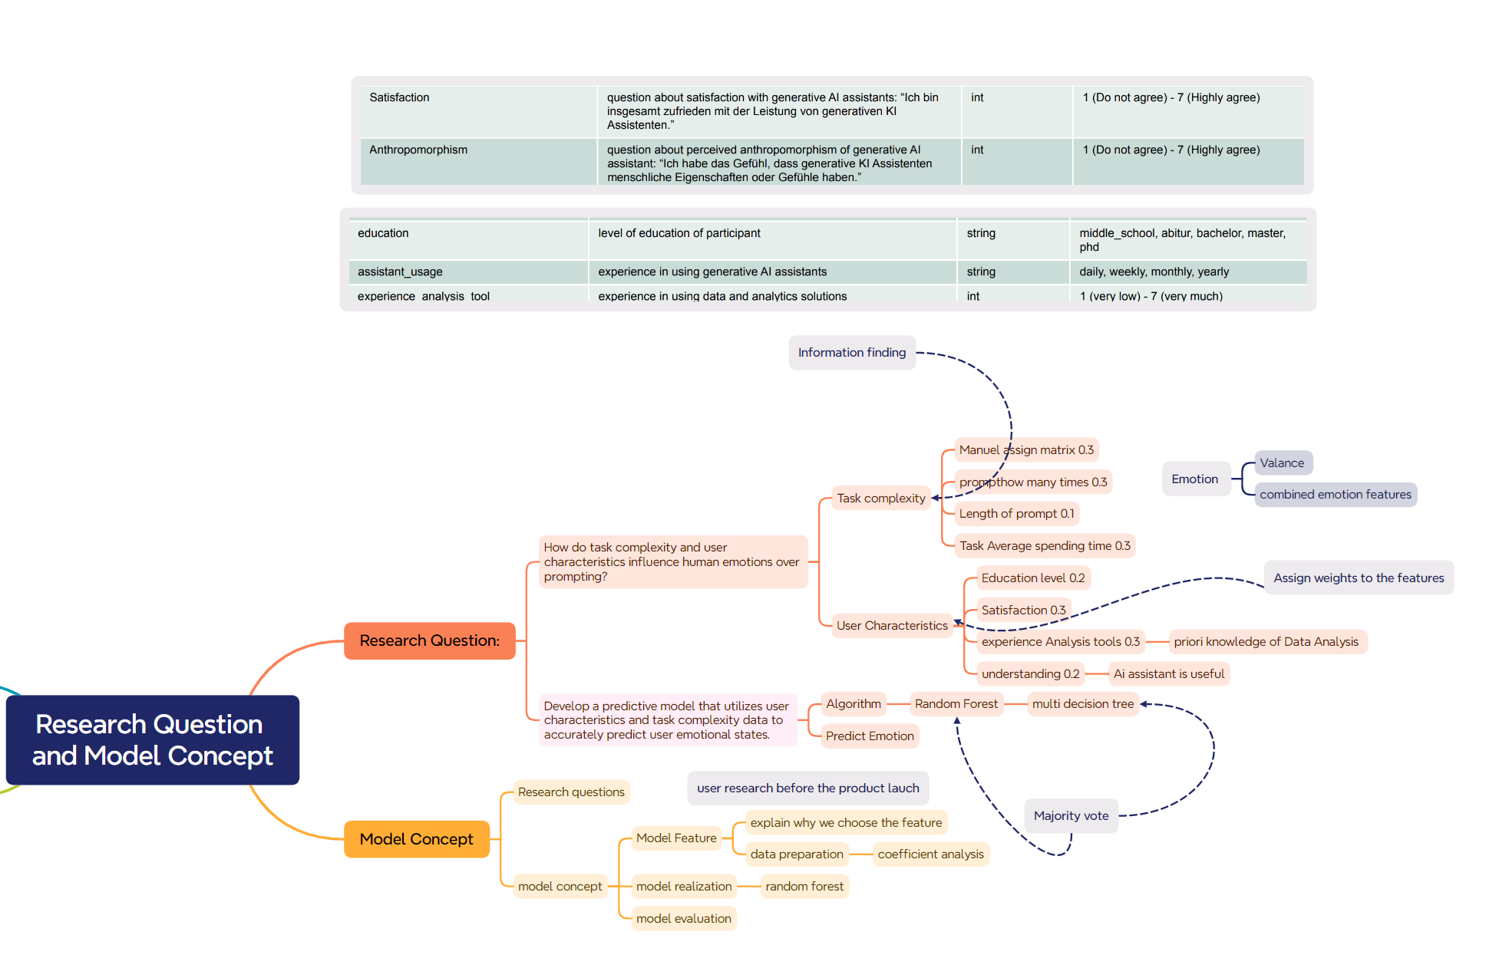

Slide 11
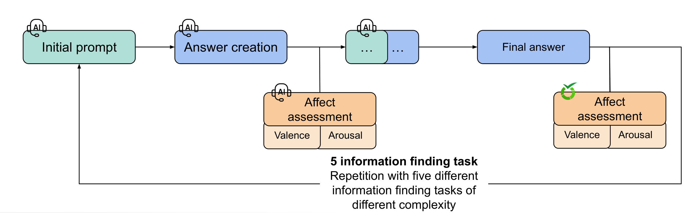
Backup

Slide 12
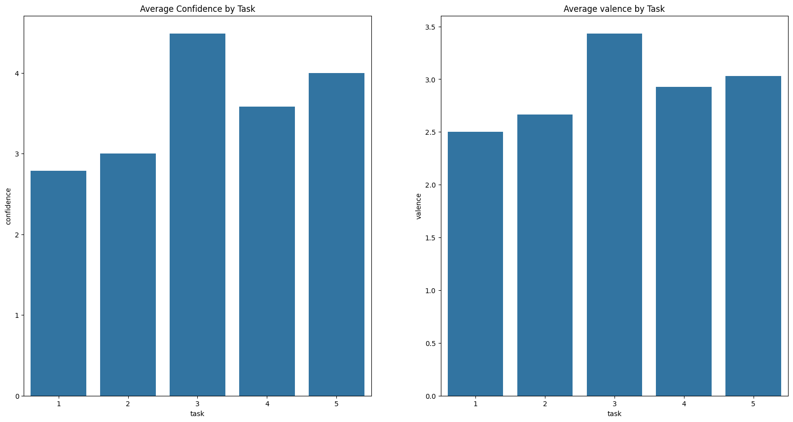
Backup-Task Complexity

